Slide 1
EXTRACT, TRANSFORM AND LOAD: SENTIMENT ANALYSIS
KEVIN PATE, KERI BROUGHTON, BOWEN YA, CARL BURKS, TERRENCE ATKINSON

Slide 2
HYPOTHESIS
We expect that the reviews will be better than neutral.

Slide 3
DATA SUMMARY
Our data was a pair of CSV files that contained information on phone reviews. One set contained the list of phone reviews and had a length of about 7500 records. The other set of data contained a list of phone models on which the individual reviews were captured.

Slide 4
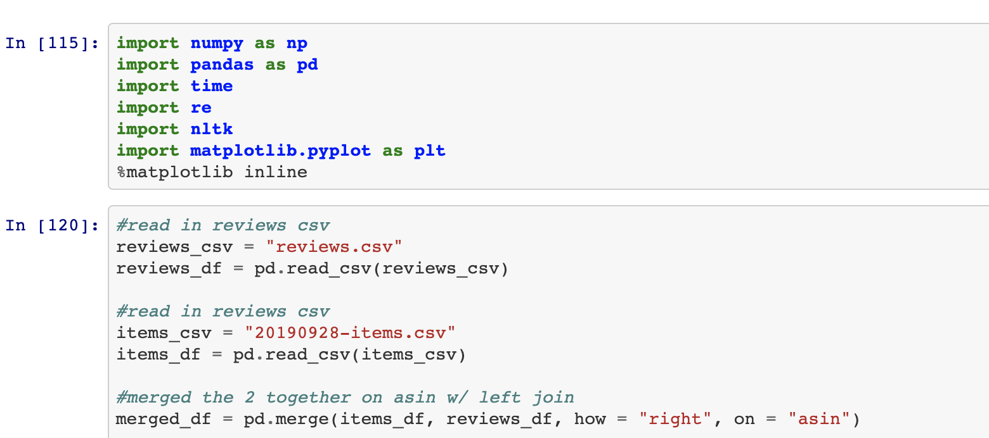
EXTRACTION
Data was extracted to using a Python data frame.
Notes:
Tried Postgres but the data was somehow corrupted after we joined the two csv files and imported them to Python.

Slide 5
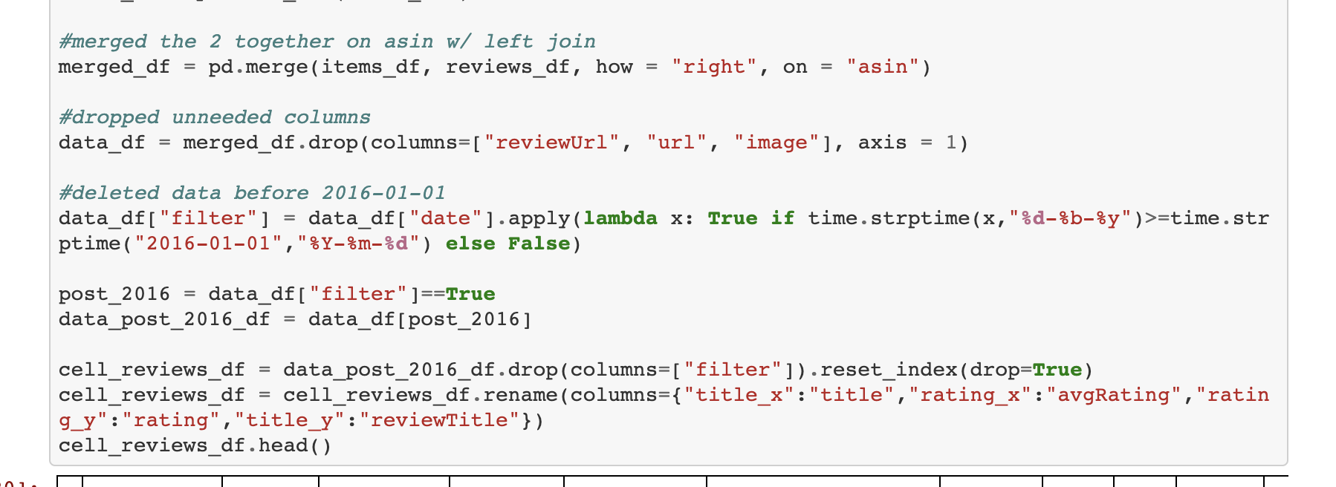
TRANSFORMATION
Rows that were not needed were dropped.

Slide 6
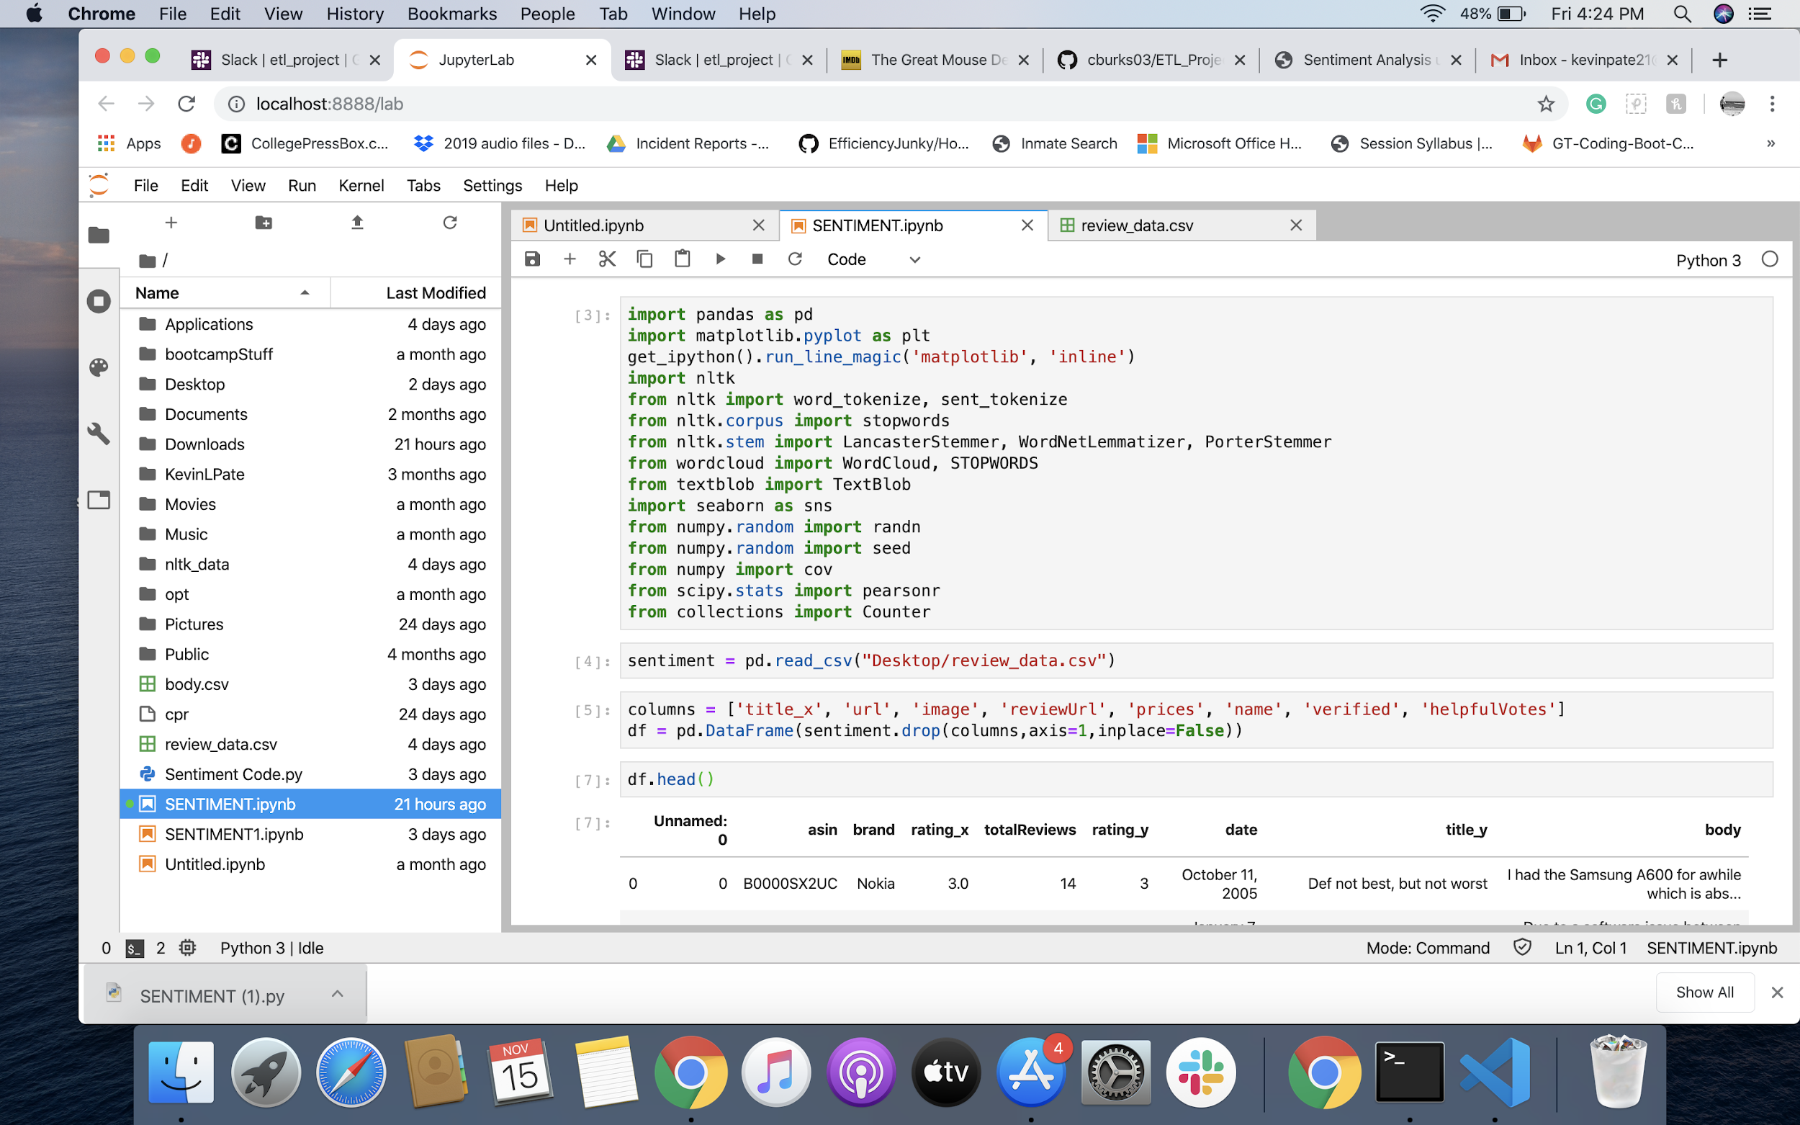
SENTIMENT ANALYSIS
Transformed csv file is being loaded into Jupyter for the Sentiment Analysis.

Slide 7
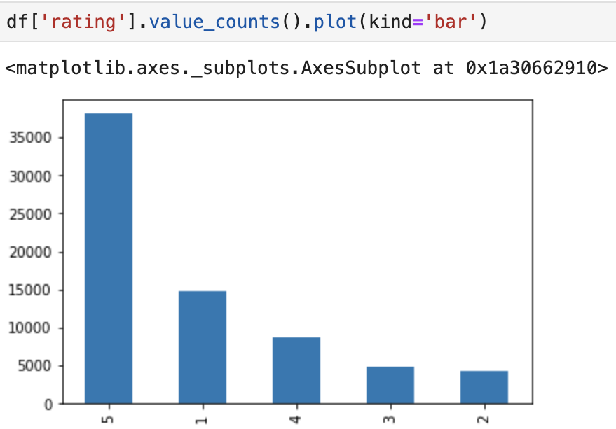
SENTIMENT ANALYSIS

Slide 8
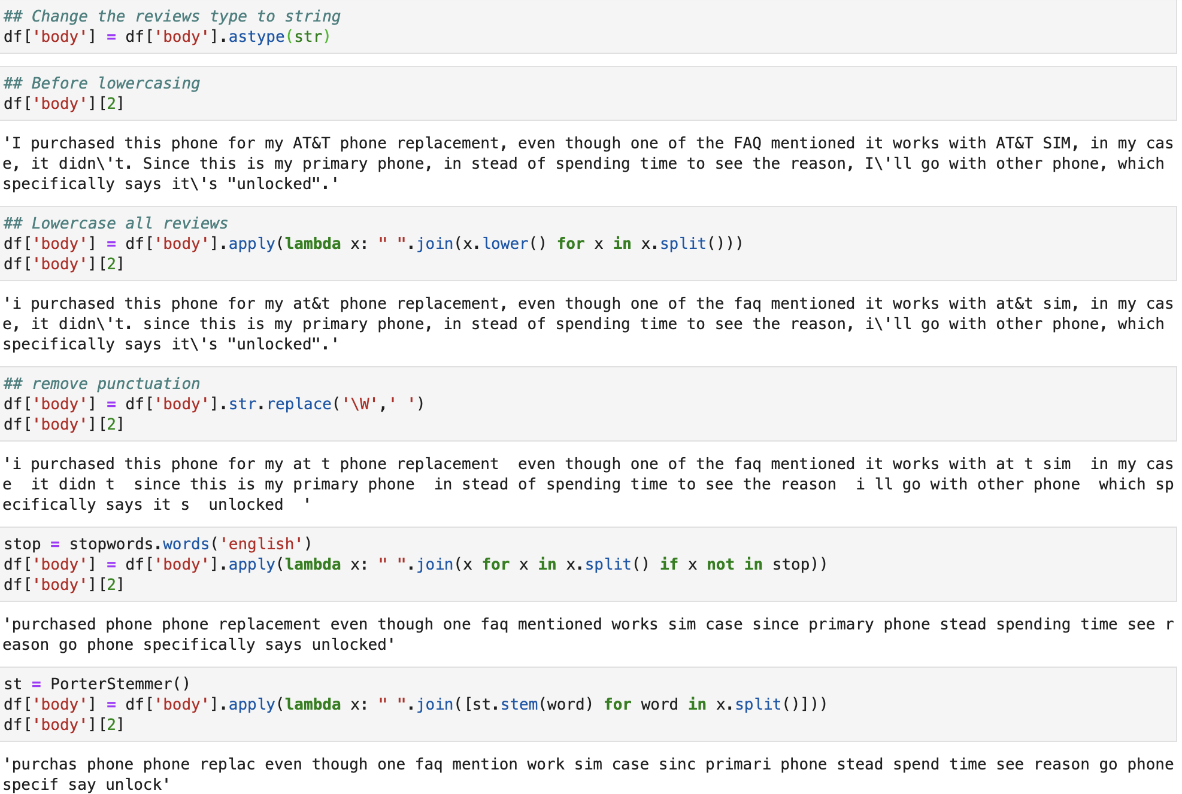
SENTIMENT ANALYSIS

Slide 9
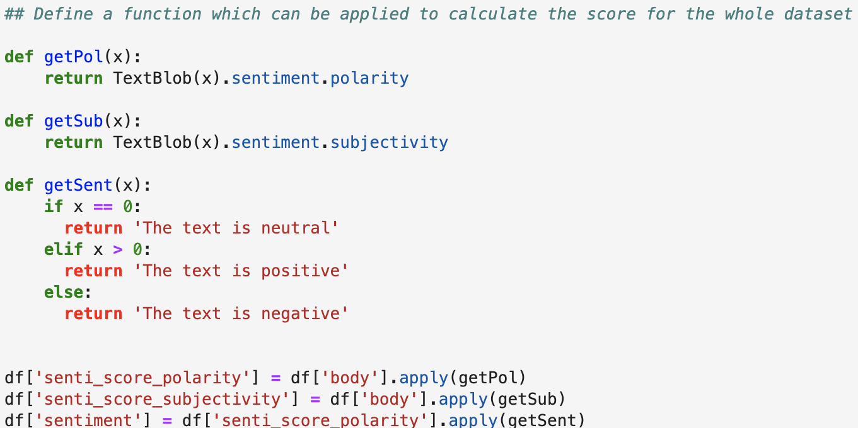
SENTIMENT ANALYSIS

Slide 10
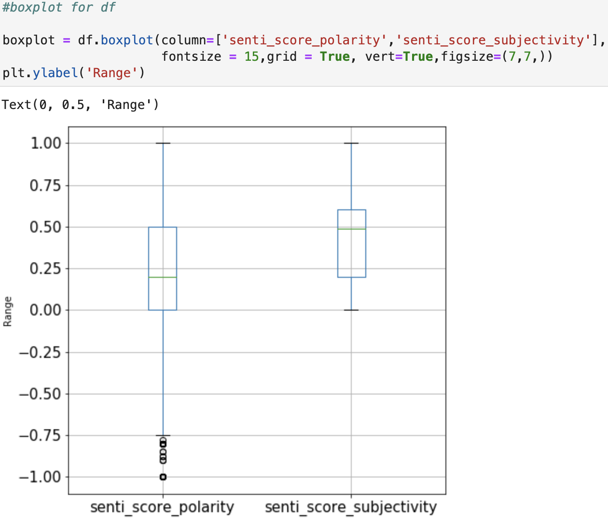
BOX PLOT SHOWING POLARITY AND SUBJECTIVITY

Slide 11
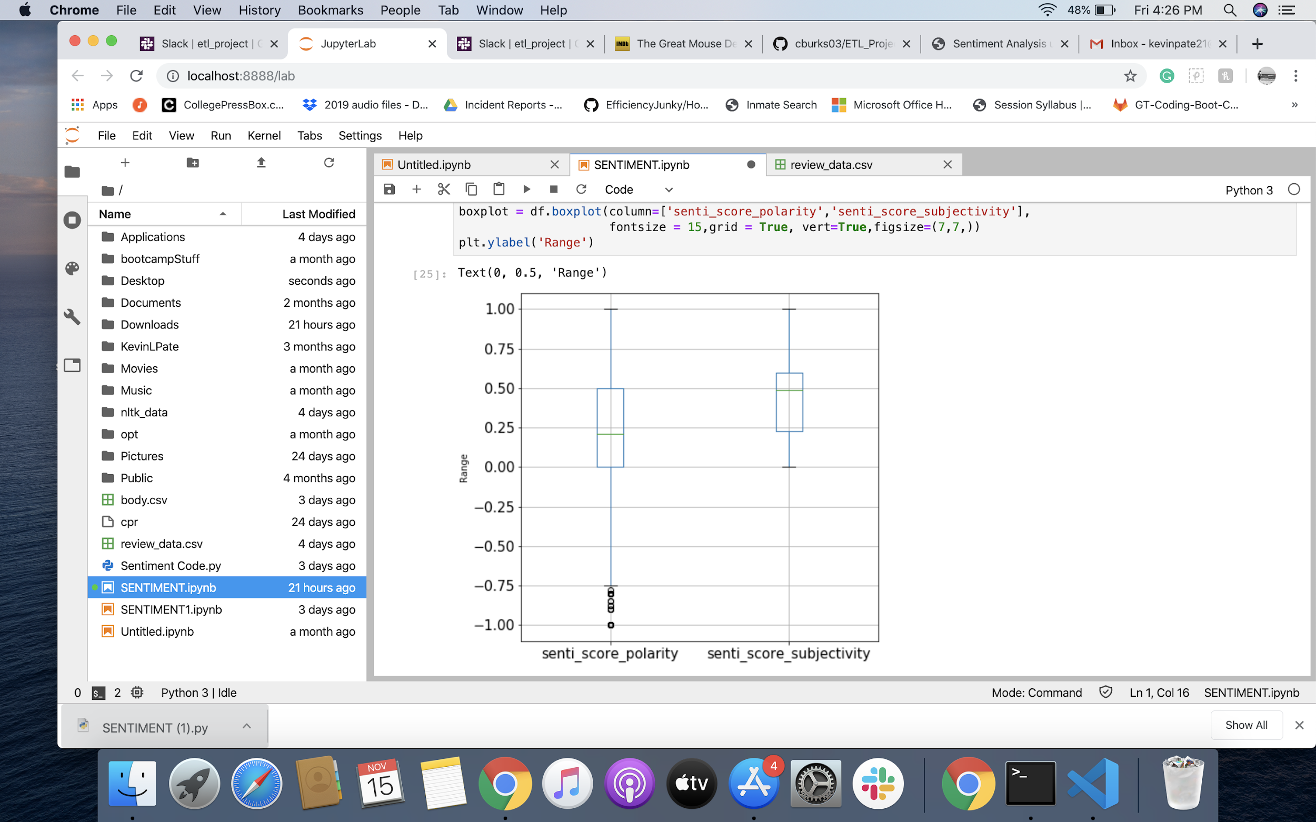
SENTIMENT ANALYSIS

Slide 12
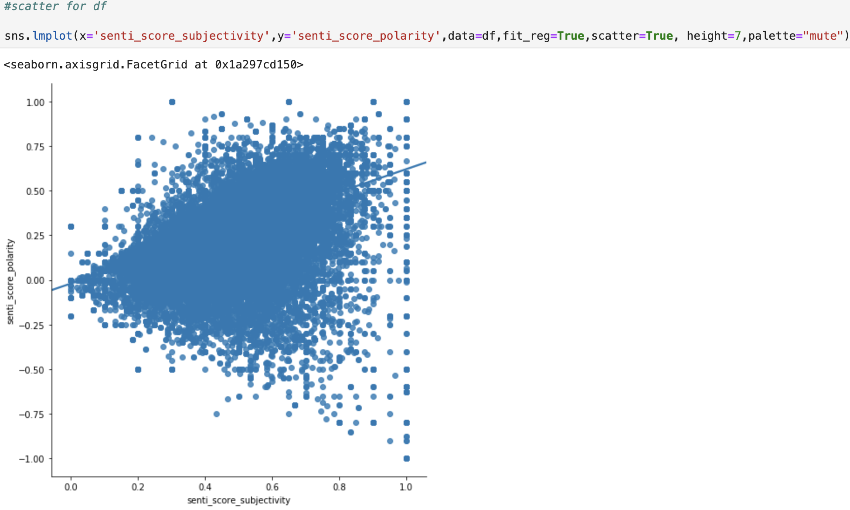
SCATTER PLOT SHOWING POLARITY AND SUBJECTIVITY

Slide 13
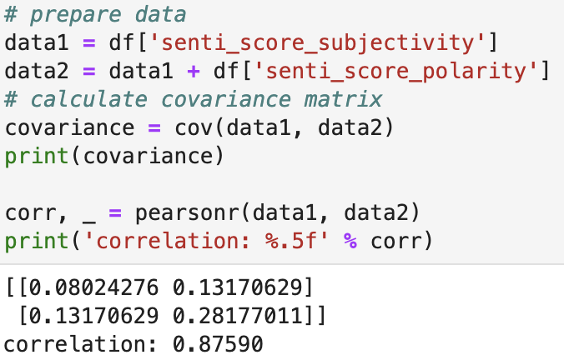
COVARIANCE AND CORRELATION

Slide 14
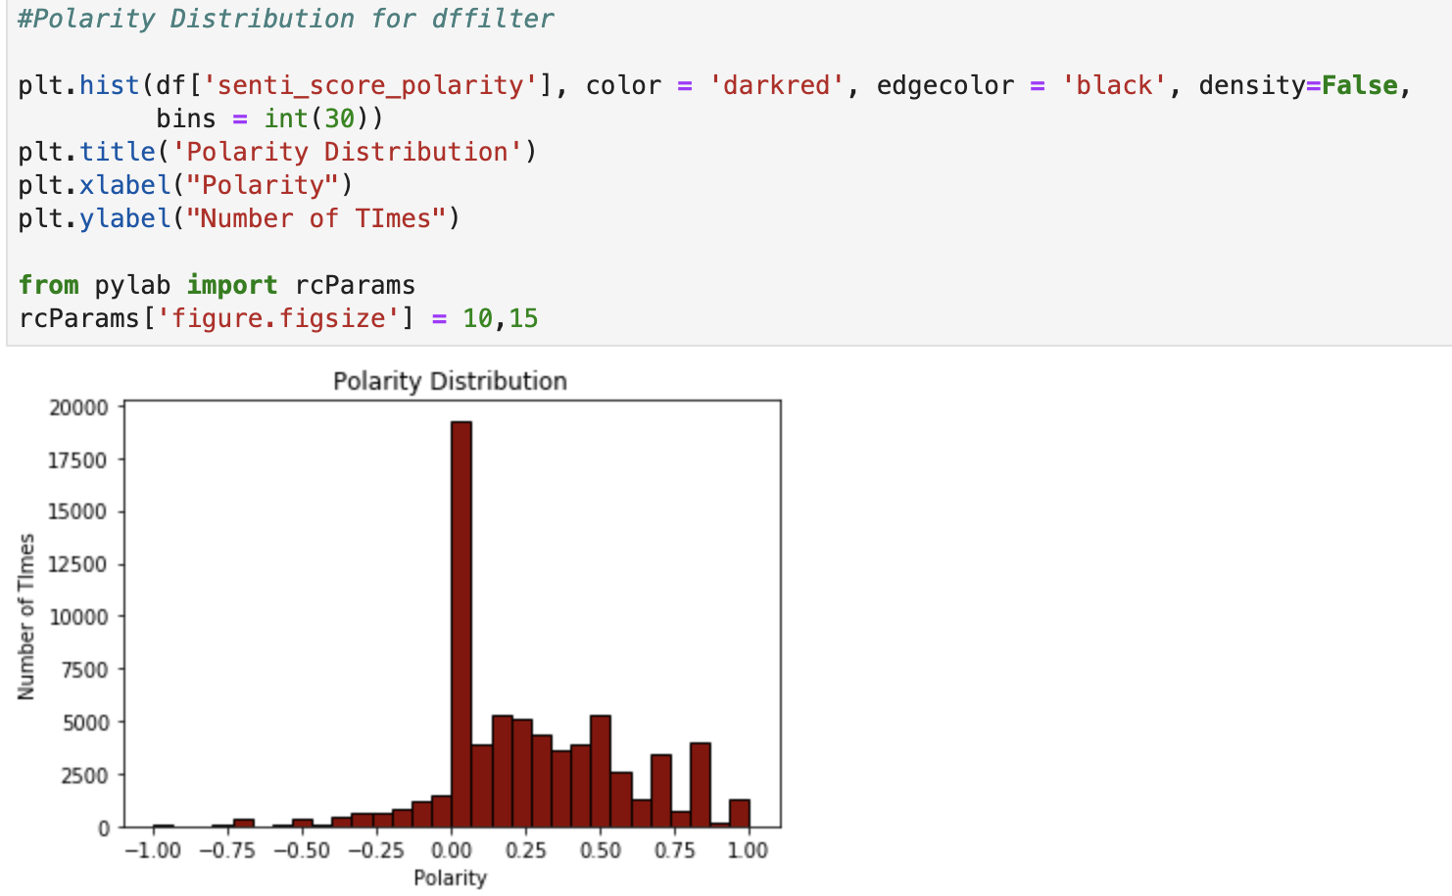
POLARITY DISTRIBUTION

Slide 15
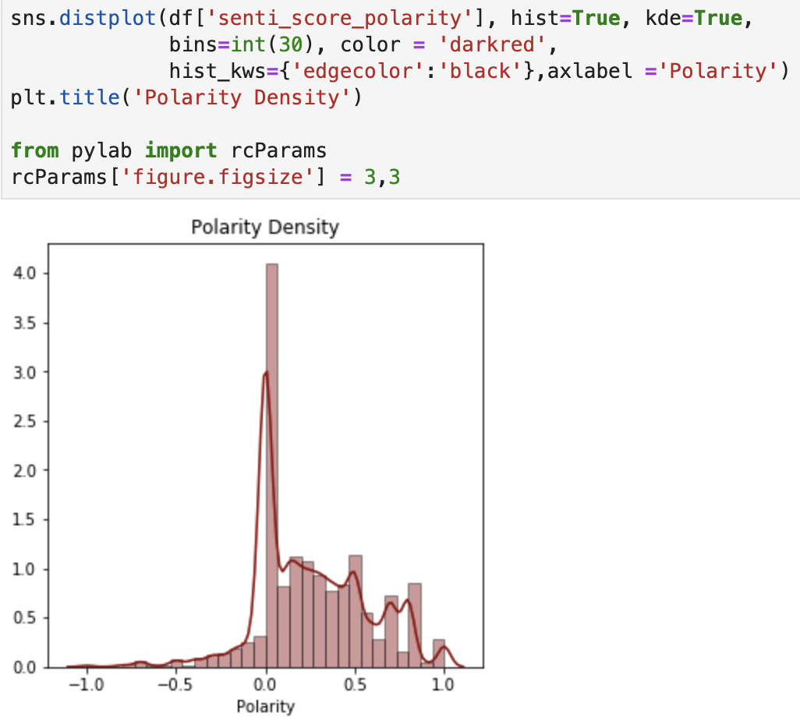
POLARITY DISTRIBUTION WITH DENSITY CURVE

Slide 16
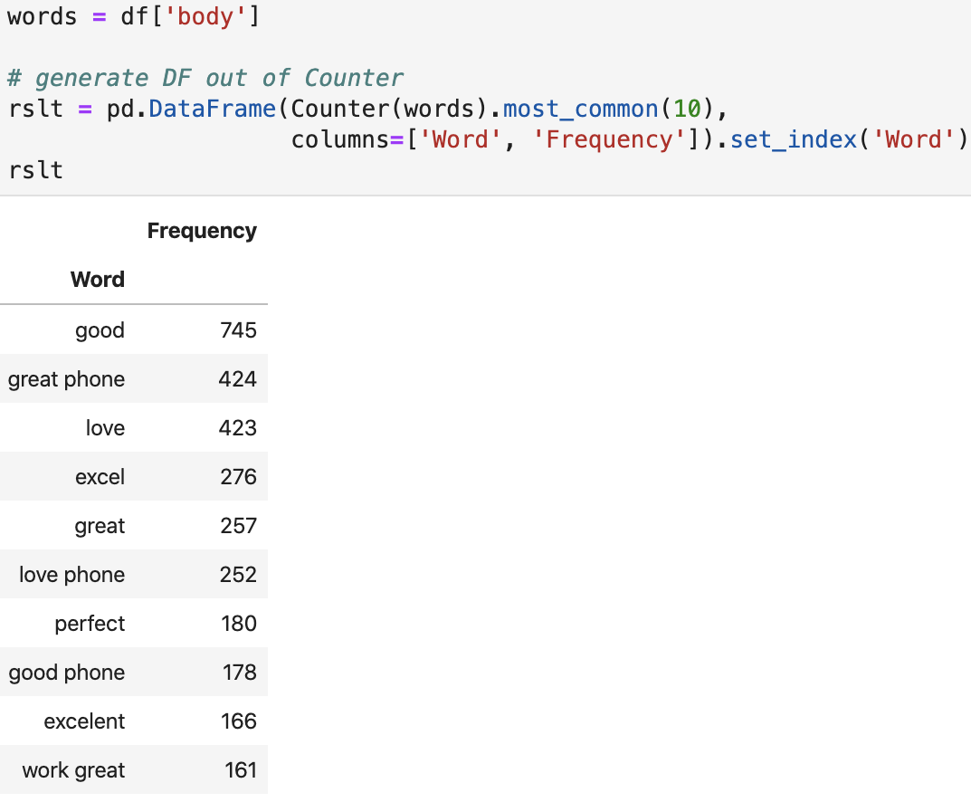
FREQUENTLY USED WORDS

Slide 17
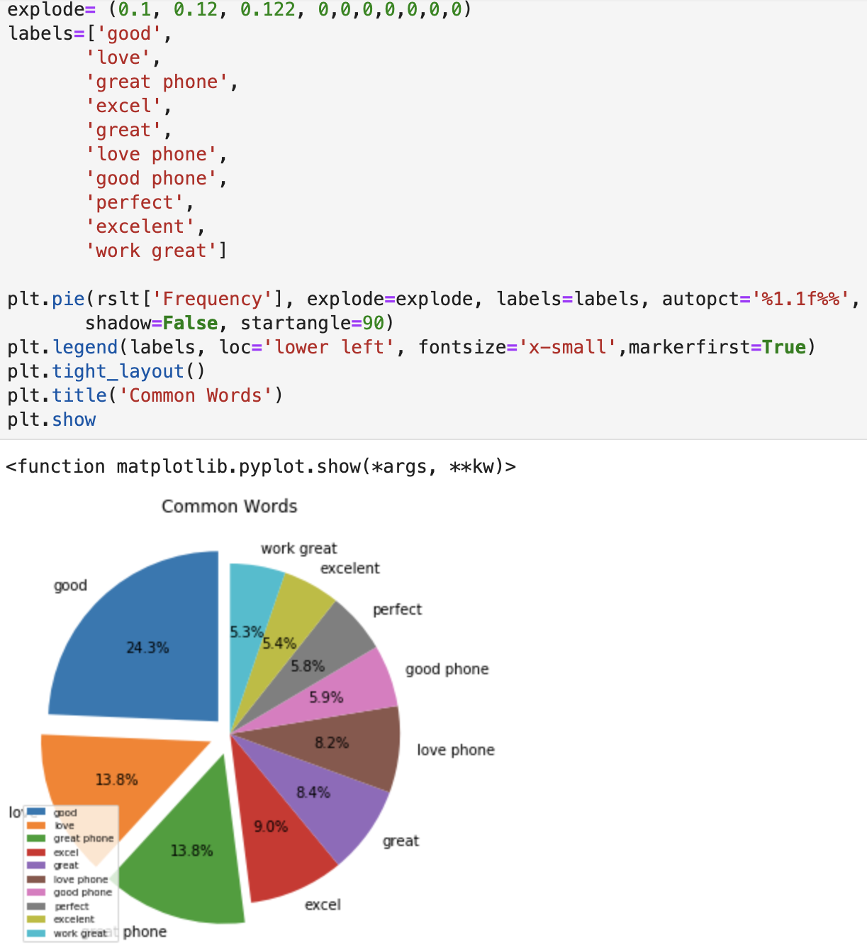
SENTIMENT ANALYSIS

Slide 18
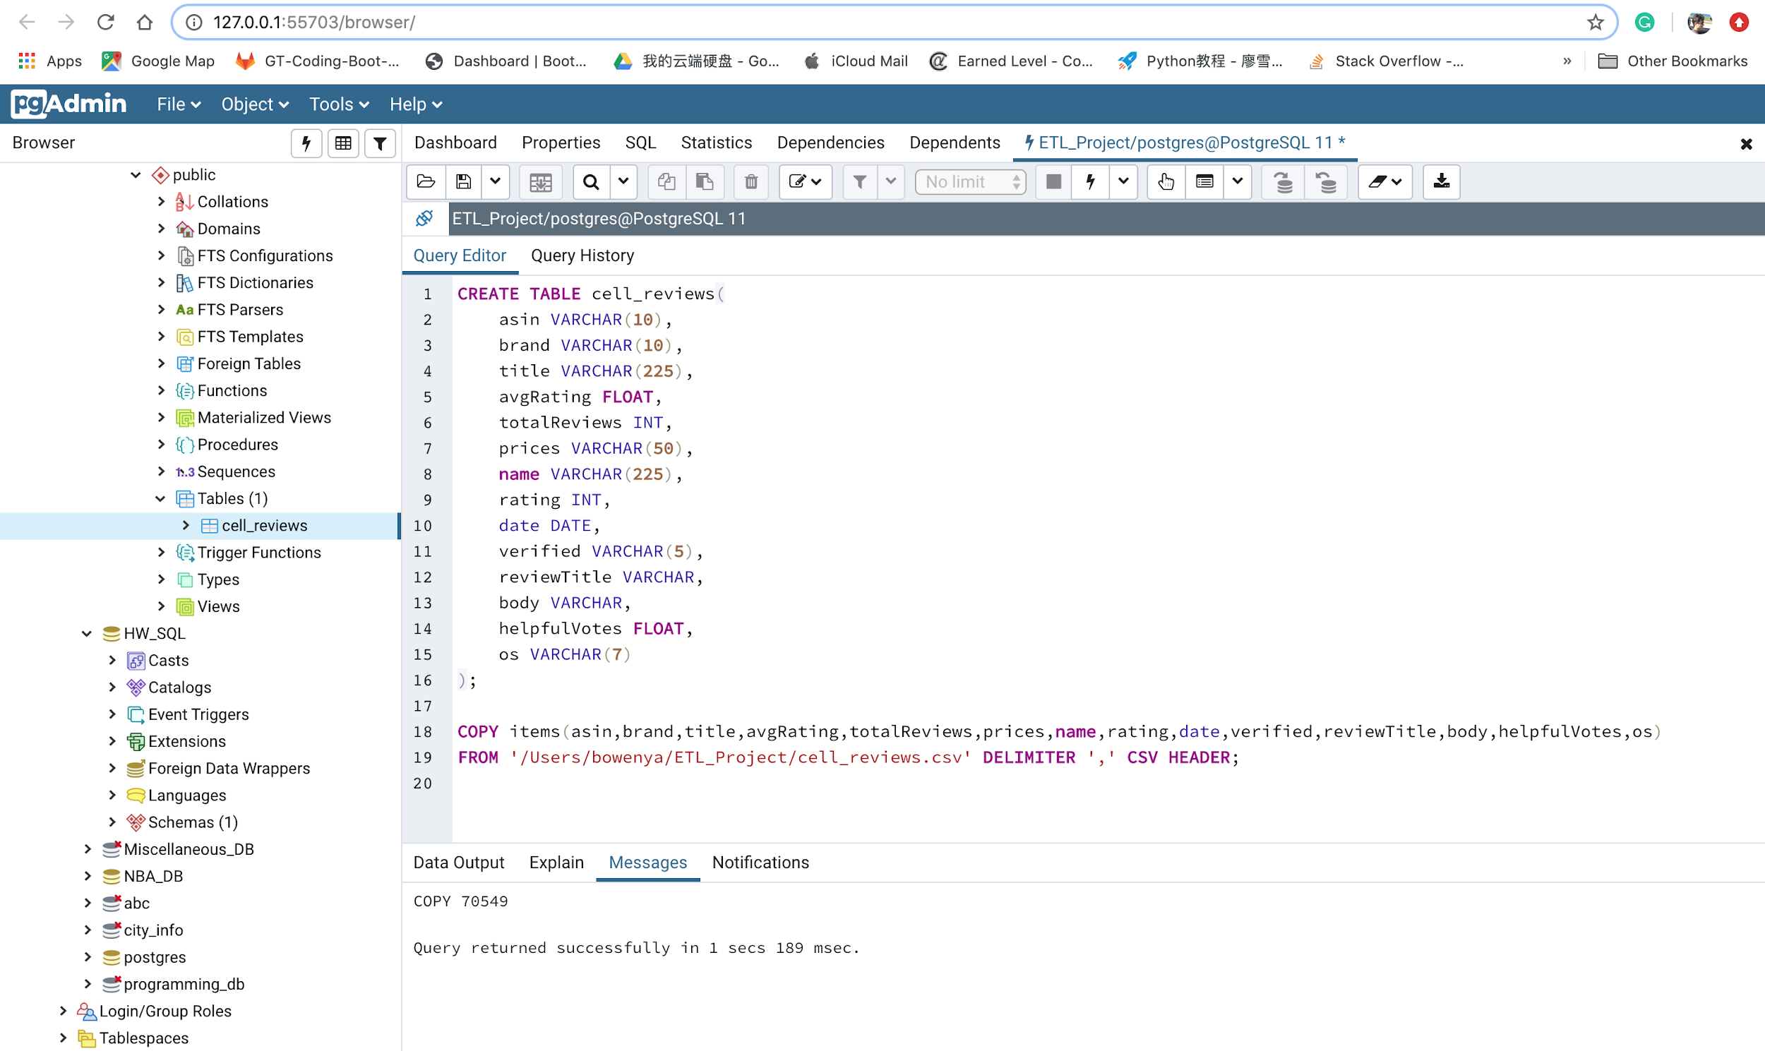
LOAD

Slide 19
CONCLUSION
Our sentiment analysis showed that the average reviews were better than neutral. It also showed that people tend to be a bit more subjective in their reviews of their Amazon phone purchases. Our data was highly correlated (0.8759), which means our findings are strong.

